Slide 1
INTRODUCTION TO DESIGN PATTERNS
IN710 OOSD 2016
Session 4.1w Ways to Look at Class Design

Slide 2
Personnel Management System
You have been hired to build a personnel management system.
You have performed your requirements analysis and designed an Employee class
You have determined that each employee has a Position (e.g. lecturer, senior lecturer, administrator, manager) and a Salary Band (1 to 7) that can be used to determine their monthly salary.
Notes:
We do RA later…..

Slide 3
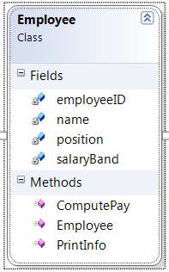
Personnel Management System
Your Employee class has a computePay() method that works out the gross income and removes the tax as appropriate
Notes:
Here’s your class.
There are more data and methods, of course, this just shows the ones we need for discussion
The object knows how to print itself out neatly for reports, and it knows how to compute the pay by taking the salary minus the tax

Slide 4
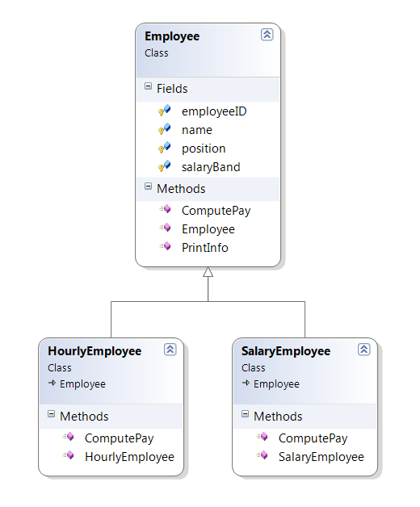
Personnel Management System
Then you discover that there are employees who are payed on an hourly basis, not salary.
What do you do?
Notes:
Presumably someone will say “inheritance”….
Ok, so we can descend here, make computePay virtual, and allow each class to override the computePay() method

Slide 5
Personnel Management System
Then you discover that there are contract employees who work for a bulk sum…
And there are student employees who work for course fee credit…..
And there are volunteer employees, who don’t get paid at all…..
Notes:
Do you want to make a new class for each of these?
You could, although it’s getting to be a lot of classes….

Slide 6
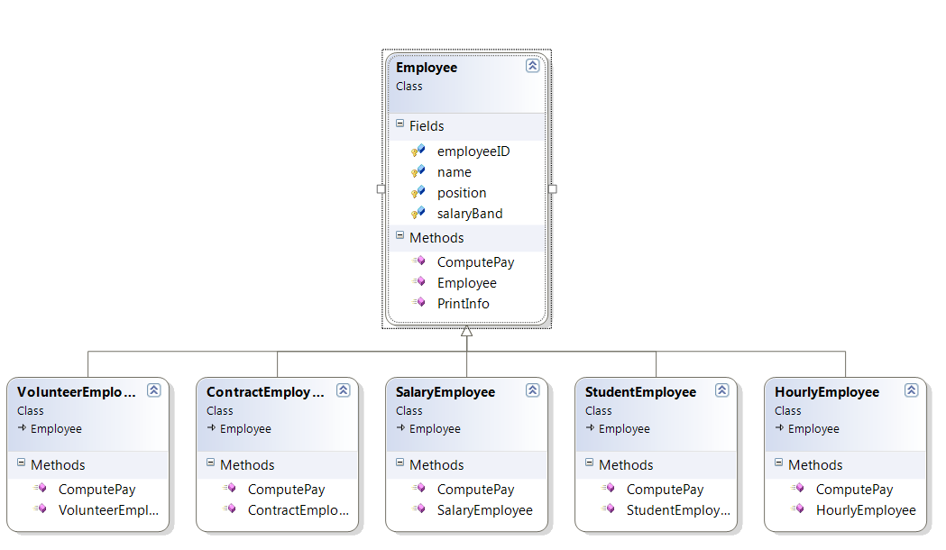
Personnel Management System

Slide 7
Personnel Management System
And then, just when your computePay() system is finally working, Management introduces paid parking.
There are several different types of permit – reserved, shared, distant lot, etc.
The permit calculation depends not on type of job, but on amount paid for the permit.
Now each employee needs an issuePermit() method, but not all members of your existing subclasses want the same issuePermit() method…..
Notes:
So how is your class diagram looking now?
Factorial descendant? Salaried-Permit1, Salaried-Permit2,

Slide 8
Personnel Management System
Then, while you’re still trying to figure out how to deal with a factorial number of leaf classes….
….Management tells you that you have to be able to easily change employees from one kind to another (for example, from Volunteer to Hourly, or from Reserved to Shared parking)
Notes:
You’ve already assigned the guy to a class.
How will you change him? Delete him and recreate him? Does he get a new ID? What about data storage then? What if you’ve got him in hash tables? Waaah!

Slide 9
Personnel Management System
Clearly, inheritance is not working for you here.
Problem features:
  Different objects want to use different strategies or algorithms for computations.
  Objects want to be able to dynamically change their strategies during their lifetimes.
Notes:
You need a better approach than inheritance.
Think about this. We frequently deal with situations where different objects want different versions of things and want to change them dynamically.
What are those things?
Those things are their DATA PROPERTIES. Different objects hold different values, and they are easy to change.
How about we capture the whole “kindOfEmployee” and “kindofParkingPermit” thing in data properties?
This kind of data property, a “what sort of thing are you” value, is sometimes called a state variable.
Then we wouldn’t even need child classes, we could just bundle everything up into the parent…..

Slide 10
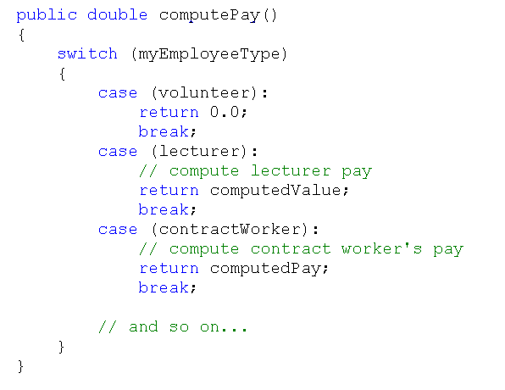
Personnel Management System
Notes:
How do you like it?
You’ll have switch statements like these everywhere you make decisions based on your state variables.
And then, you just know management is going to want you to add new employee types, or new parking permit types.
What code will you have to touch then?
How does that sit with the open/closed principle?
How horrible is your life now?

Slide 11
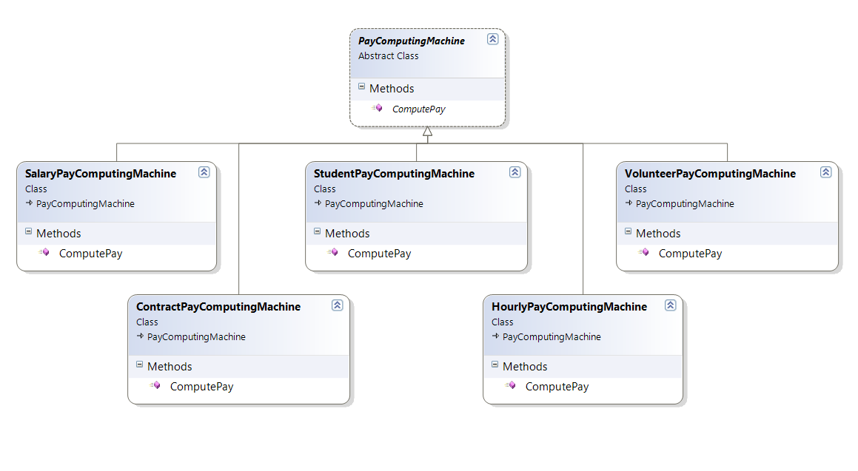
Personnel Management System
Notes:
We were moving in the right direction when we wanted to use a data property (state variable) to determine a behaviour.
So why not just continue that way? Why not give each employee a thing that actually does the behaviour, a little object to do the work it needs done?
Like a little machine to compute its pay.
That object would have to be an instance of some class that you define.
Here’s what such a class (hierarchy) might look like.
Class PayComputingMachine and its descendants for salary, hourly, volunteer, etc.
Note that in the base class, the computePay() method is in italics. This indicates that it is abstract. This means that every child MUST provide code. Which is exactly what you want.
Any alternative? In this case, since it only has methods and no default implementations, it could be an interface…

Slide 12
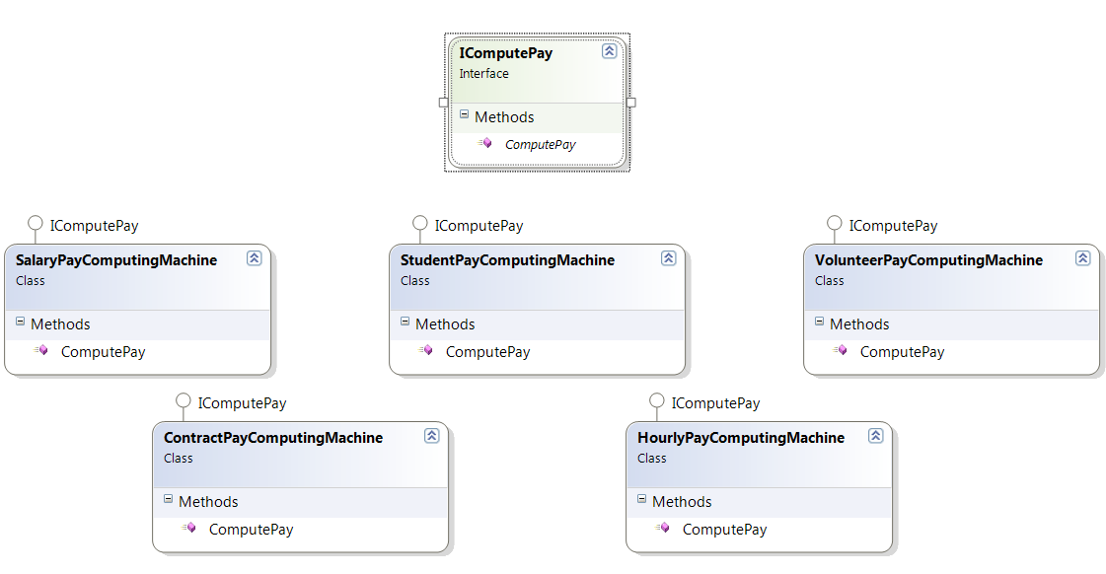
Personnel Management System
Notes:
The VS diagram looks a little different, which is good, since interface implementation and parent class inheritance aren’t the same thing…
Now each of our classes implements IComputePay, rather than extending (descending from) an abstract PayComputingMachine class.
Refer to our discussion of how to choose an abstract class vs an interface.
In a situation as simple as this one, it doesn’t make much difference, but since the payComputingMachines share only a polymorphic method, an interface would be more idiomatic.
If the computing machines had shared data or default method implementations, you would use an abstract class.

Slide 13
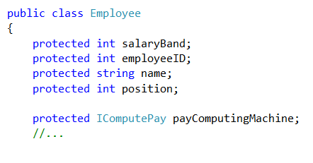
Personnel Management System
Notes:
So what happens to Employee?
He needs an IPayComputingMachine object
When he wants to compute his pay, he just invokes the computePay() method of his IPayComputingMachine object

Slide 14
Personnel Management System
Where do you instantiate (create) the PayComputingMachine or IComputePay object for each Employee?
What do you do if management asks you to add a new category of pay calculation?
How do you change an employee’s pay category?
Notes:
Answer 1: in the Employee child class constructor. You can continue to use the Employee class structure as before and have each child new its appropriate PayComputeMachine descendent, depending on what sort of Employee you want to make. Or, if more appropriate, you can pass it in to that constructor.
Answer 2: Just add a new child to the PayComputeMachine… tree or make a new class that implements IComputePay. Note: this is extension, not modification
Answer 3: setPayComputeMachine or property that allows you to assign a new concrete instance to its payComputingMachine data field.

Slide 15
The Strategy Design Pattern
You have just implemented your first Design Pattern
The Design Patterns are a set of common useful OO architectures.
You will learn that certain problem features signal the need for a particular pattern.
Guidelines, not immutable laws.
Notes:
Congratulations. That was the Strategy Design pattern.
First formalised by Gamma et.al. in their seminal text Design Patterns in 1995.
There were originally 23 of them.
The DP thing is an attempt to capture the pattern recognition skills that separate novice from expert.
We will look at about half a dozen of them this term.
In this case, it was the need for different objects to use different algorithms/strategies to implement a common behaviour
This often indicates that you need to abstract that behaviour out into its own class.

Slide 16
Personnel Management System
Note that you could use exactly the same technique for handling the parking permit problem.
In fact, you could do so for as many different behaviours as you needed.
Notes:
Make an abstract parking permit machine class with descendents, or make another interface, or perhaps combine the two “machines” into a single interface.
You could, in fact, have as many methods in your interface as there were “machines” required, if they were always going to occur together.
You wouldn’t bundle them up if different employees only needed different subsets of them. That would be bad design. It would violate which principle? => Interface Segregation.

Slide 17
Reading
Head-First Design Patterns Chapter 1 (on Safari and in the Robertson library)
Useful website:
  http://www.dofactory.com/Patterns/PatternStrategy.aspx
Notes:
The book also in Robertson library (3 copies last time I was over there).

Slide 18
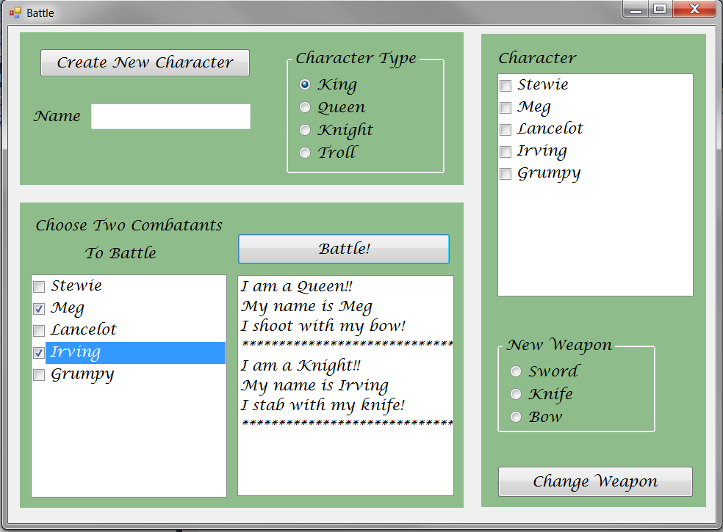
Practical 1
Notes:
We’ll discuss this one here in class, then you’ll have some to do on your own.
Build a game character class (simplified)
Four types. – King, Queen, Knight and Troll.
Common data and a common method (stating their name).
Two polymorphic behaviours (battling and declaiming).
Declaiming depends on their class type, and never changes.
Battling depends on their weapon, and can change frequently.
Look at the problem carefully, and see if you can find the pattern. Specifically, the Strategy pattern.
Then using inheritance, interface(s), etc. appropriately, build the application.

Slide 19
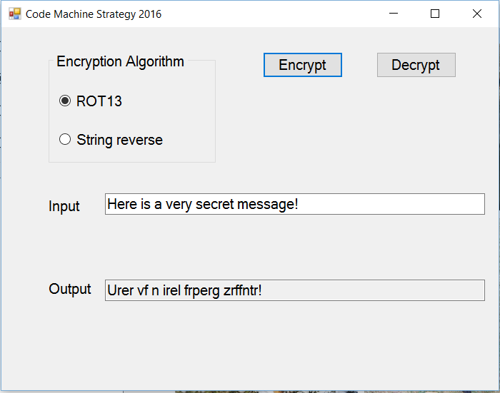
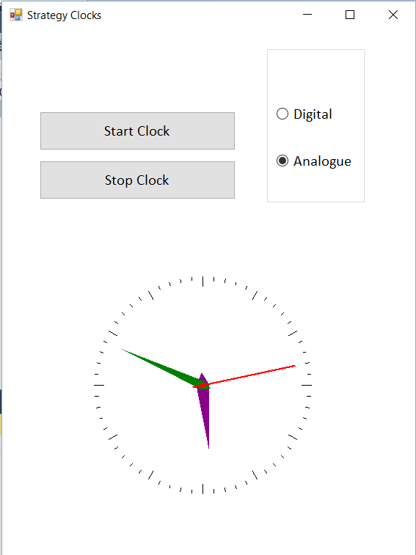
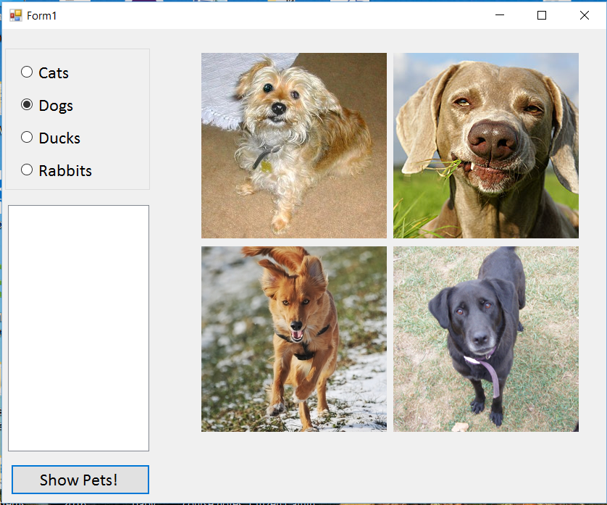
Practical 2
Notes:
These three tasks. This is a checkpoint.
See handout
Due Friday.
We will be working on these problems in class on Friday.
If you turn in before start of class on Friday, don’t come to class. If you don’t, please attend class.

